Slide 1

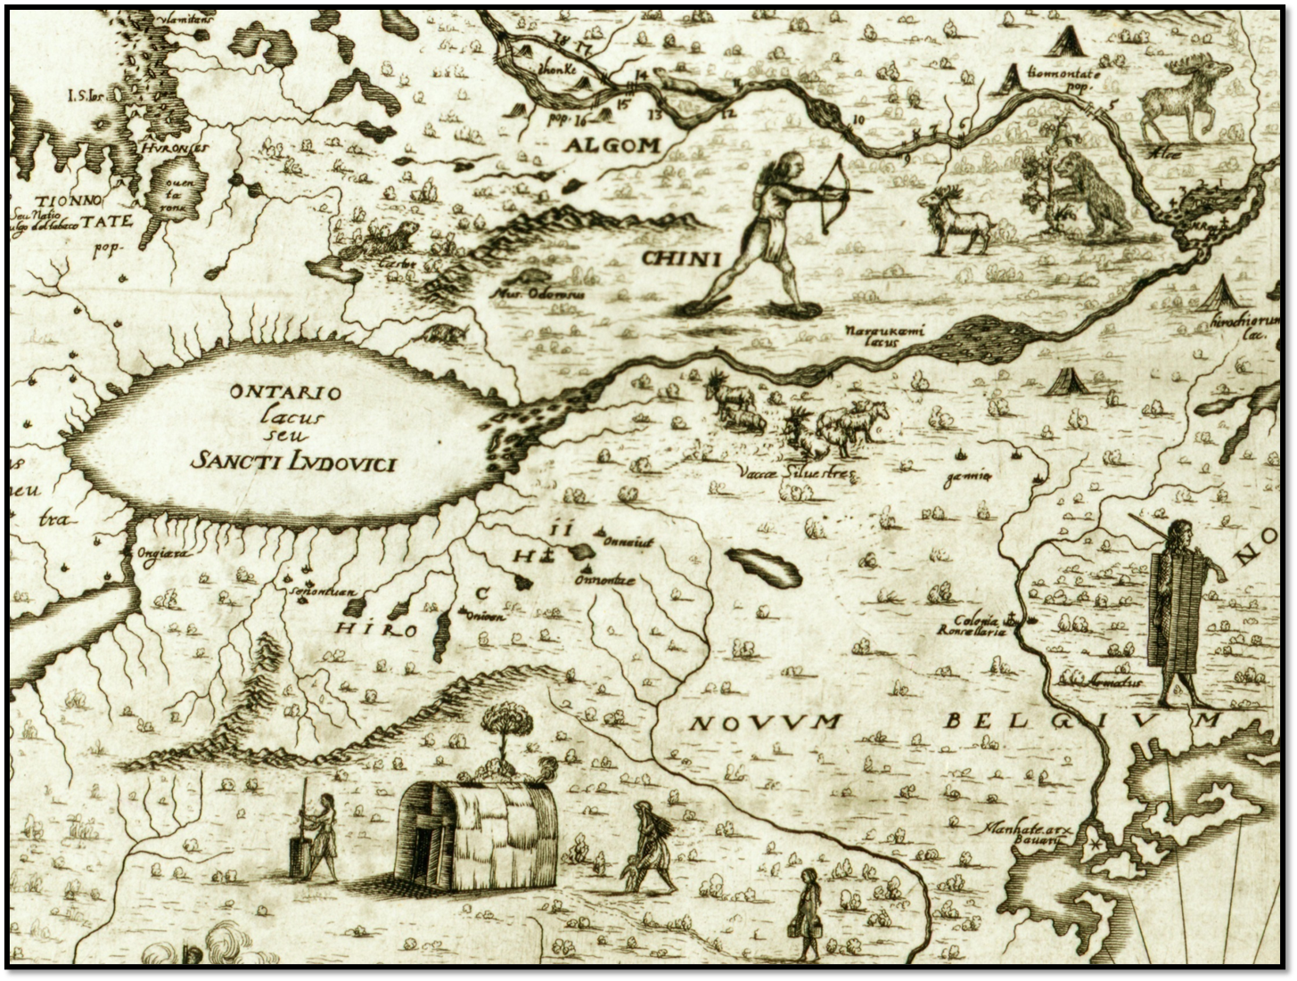

ACROSS THE LINES: MAPPING SYRACUSE
Robert Searing
Curator of History
Onondaga Historical Association
Notes:
1507 Waldsmuller Map Amerigo Vespucci

Slide 2

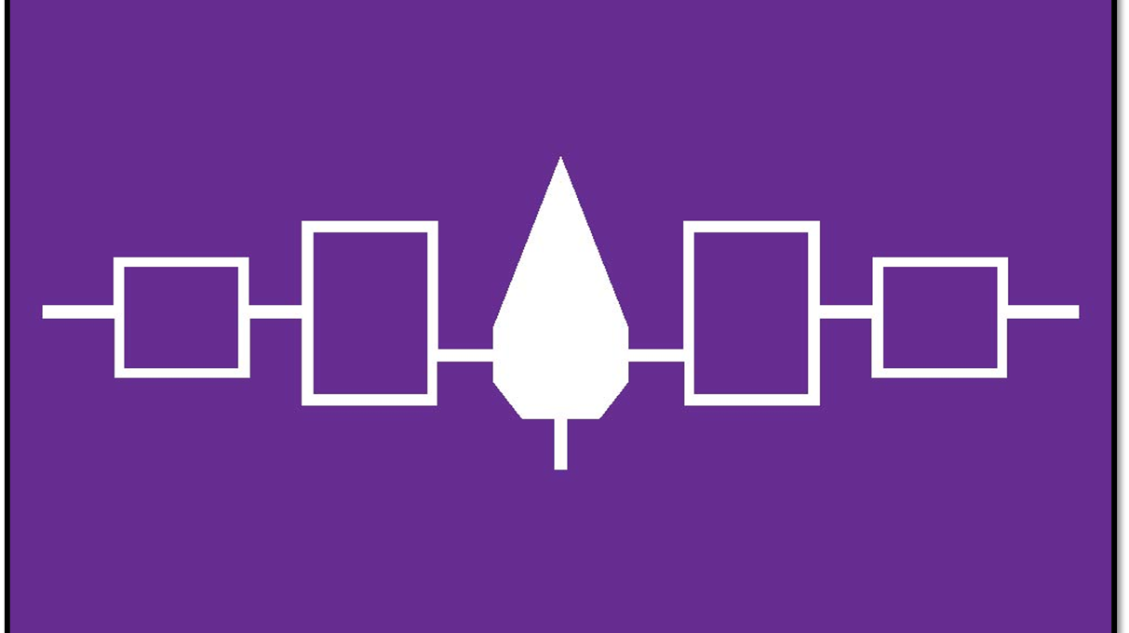
Notes:
The Hiawatha Flag represents the five nations that formed the Great Law of Peace of the Haudenosaunee Confederacy. From left the right, the symbols represent the Seneca Nation, the Cayuga Nation, the Onondaga Nation (the Central Fire of the Confederacy), the Oneida Nation and the Mohawk Nation. The Tuscarora Nation joined the Confederacy in the the early 18th century.

Slide 3
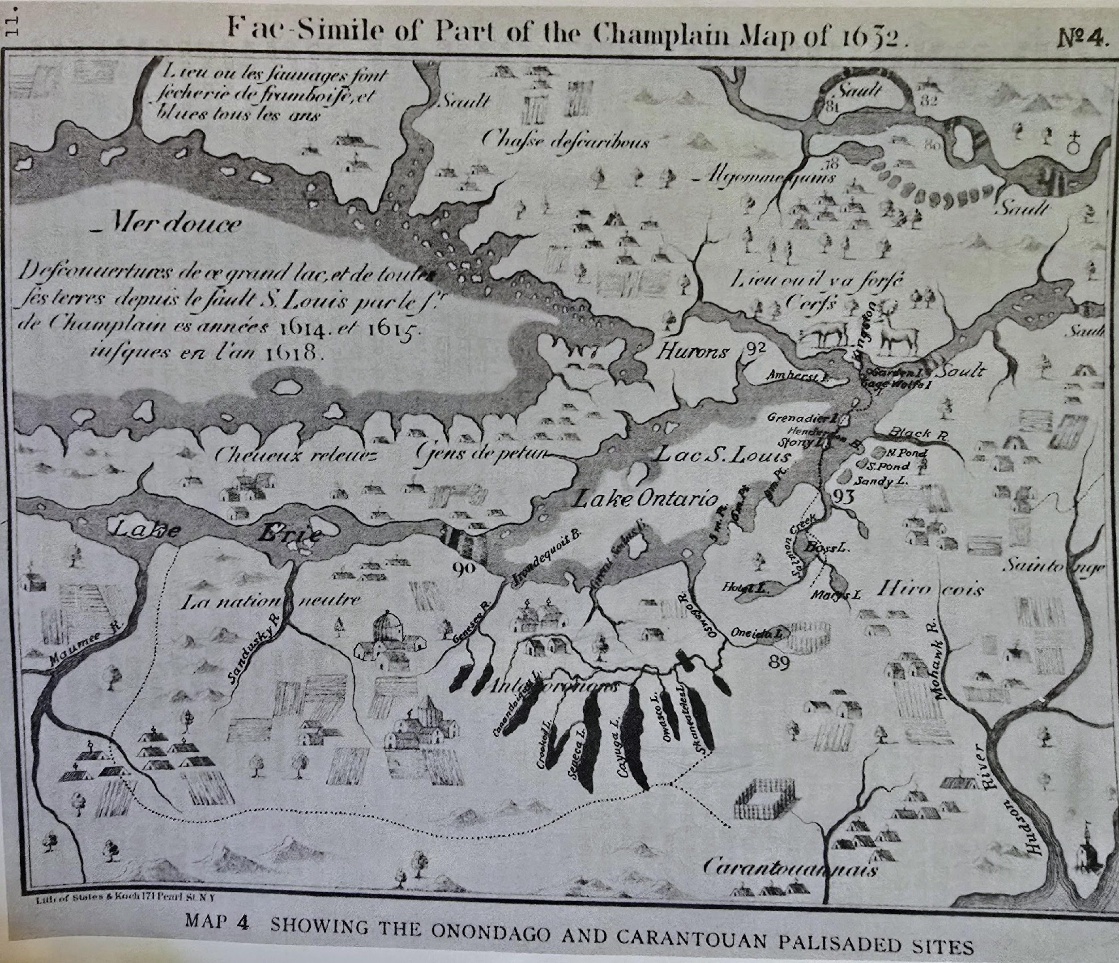
Notes:
Samuel de Champlain’s 1632 map of New France. The French explorer, navigator, diplomat, soldier, and cartographer founded Quebec City as a permanent French colony in North America. He lived among the indigenous people of the region, making ethnographic observations of the Wendat (Huron), Innu, Algonquin and Iroquois (Haudenosaunee). Jesuit Missionaries settled on the shores of Onondaga Lake in 1656, near present day Syracuse, fleeing 18 months later amidst tensions with the Haudenosaunee.

Slide 4
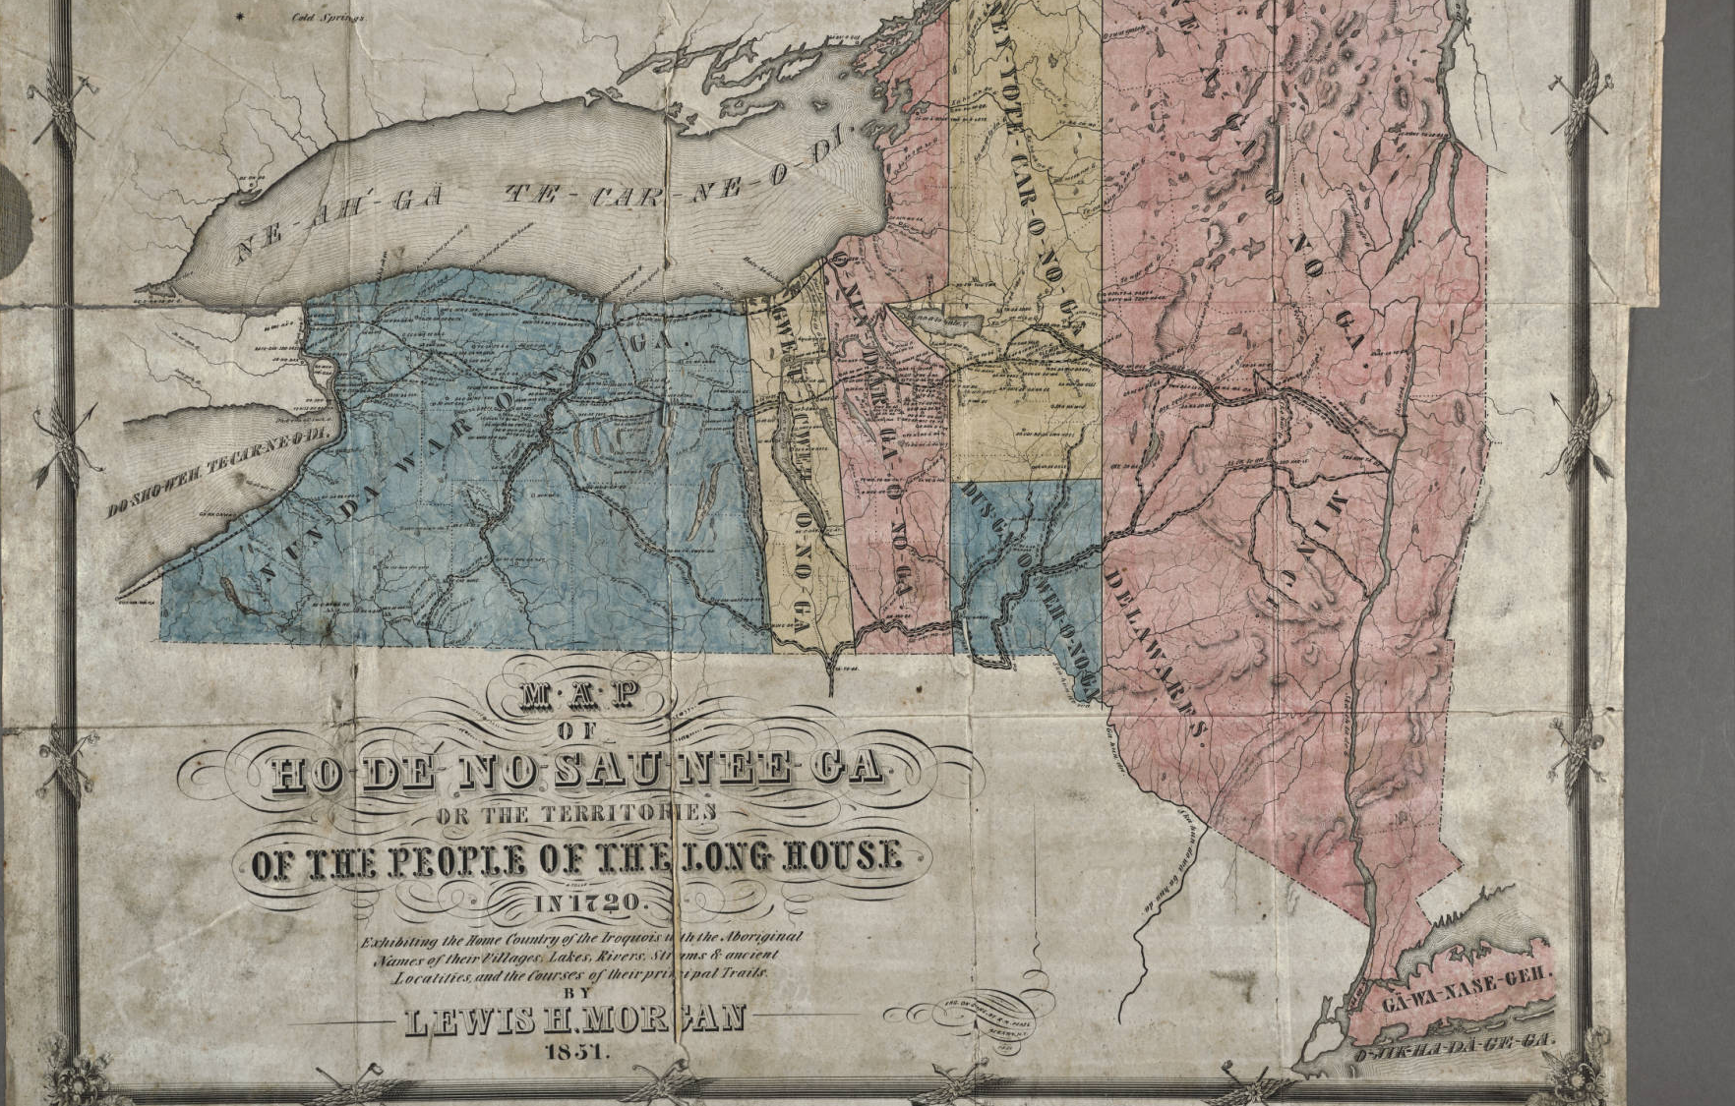
MAP OF HO-DE-NO-SAU-NEE-GA OR THE TERRITORIES OF THE PEOPLE OF THE LONG HOUSE IN 1720,LEWIS MORGAN & ELY PARKER
,
Notes:
Ely parker Ely S. Parker was born on the Seneca Reservation at Tonawanda in western New York in 1828. His parents raised him in the traditions of the League of the Haudenosaunee (also known as Six Nations or Iroquois), but also educated him at a Baptist Mission school. There, he took the first name of the school’s minister and called himself Ely Parker.

Slide 5
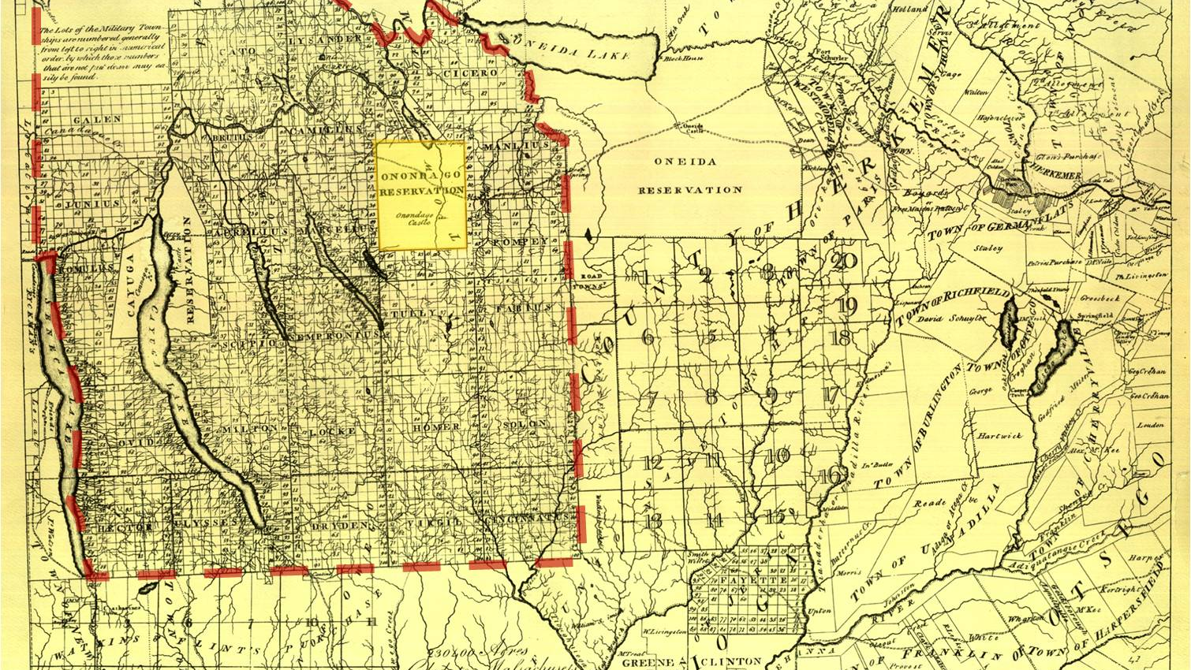
MILITARY TRACT, 1790
Simeon DeWitt, Surveyor
Notes:
On July 3, 1790, Revolutionary War veterans drew for lots in the Military Tract. The Military Tract was a vast area of land in Central New York that was divided into 28 townships, each comprised of 100 lots, with 600 acres in each lot. The townships were predominately named after famous Greeks and Romans, such as Homer, Cicero, Marcellus and Pompey, many of which have kept the same names. Soldiers were awarded between 600 and 3,000 acres depending on their rank. The Military Tract was taken from the territory of the original inhabitants of New York state, the Haudenosaunee, or Iroquois as they are more commonly known; specifically, the Onondaga and Cayuga nations. According to the Onondaga Nation, between 1788 and 1822, the Onondaga Nation lost possession of approximately 95% of its land as more Americans/Europeans moved into Upstate New York. The boundary of the Onondaga Reservation in 1790 included the land that was eventually developed into City of Syracuse.

Slide 6
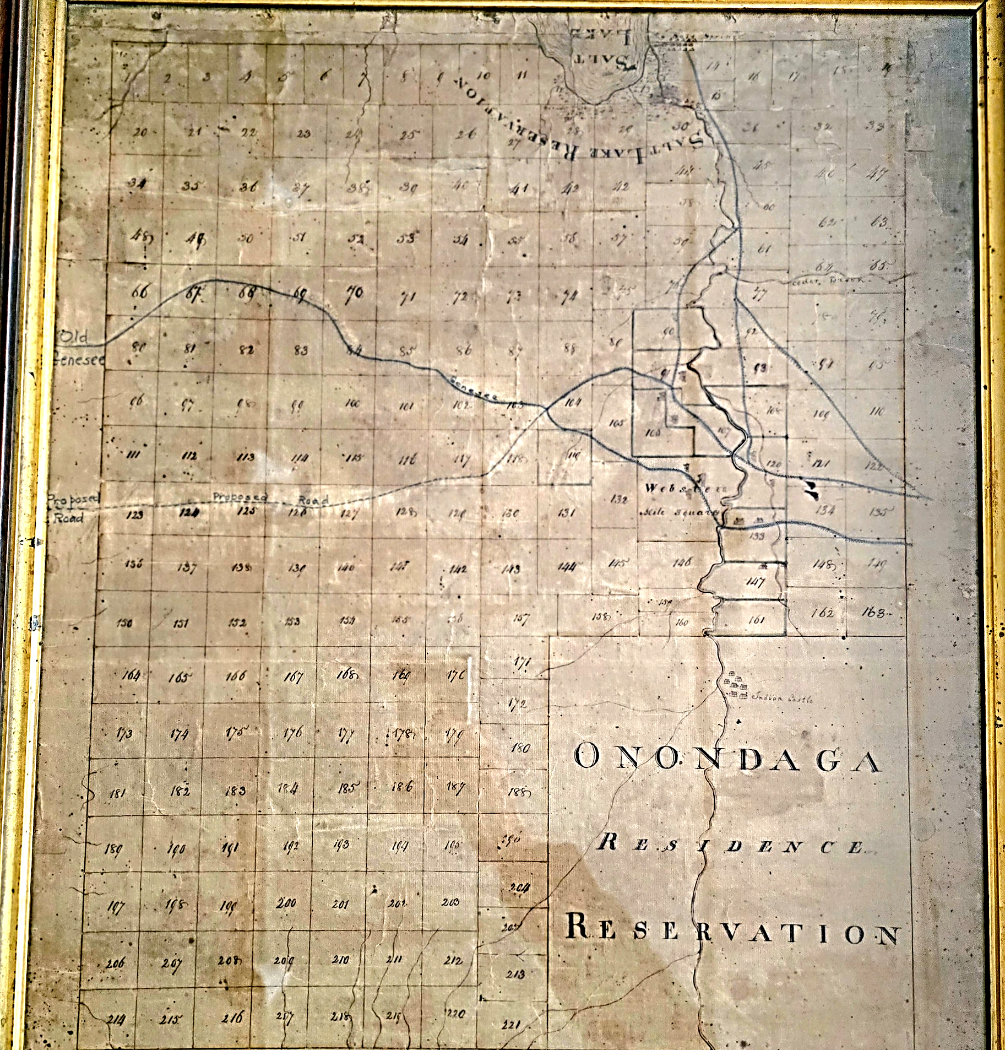
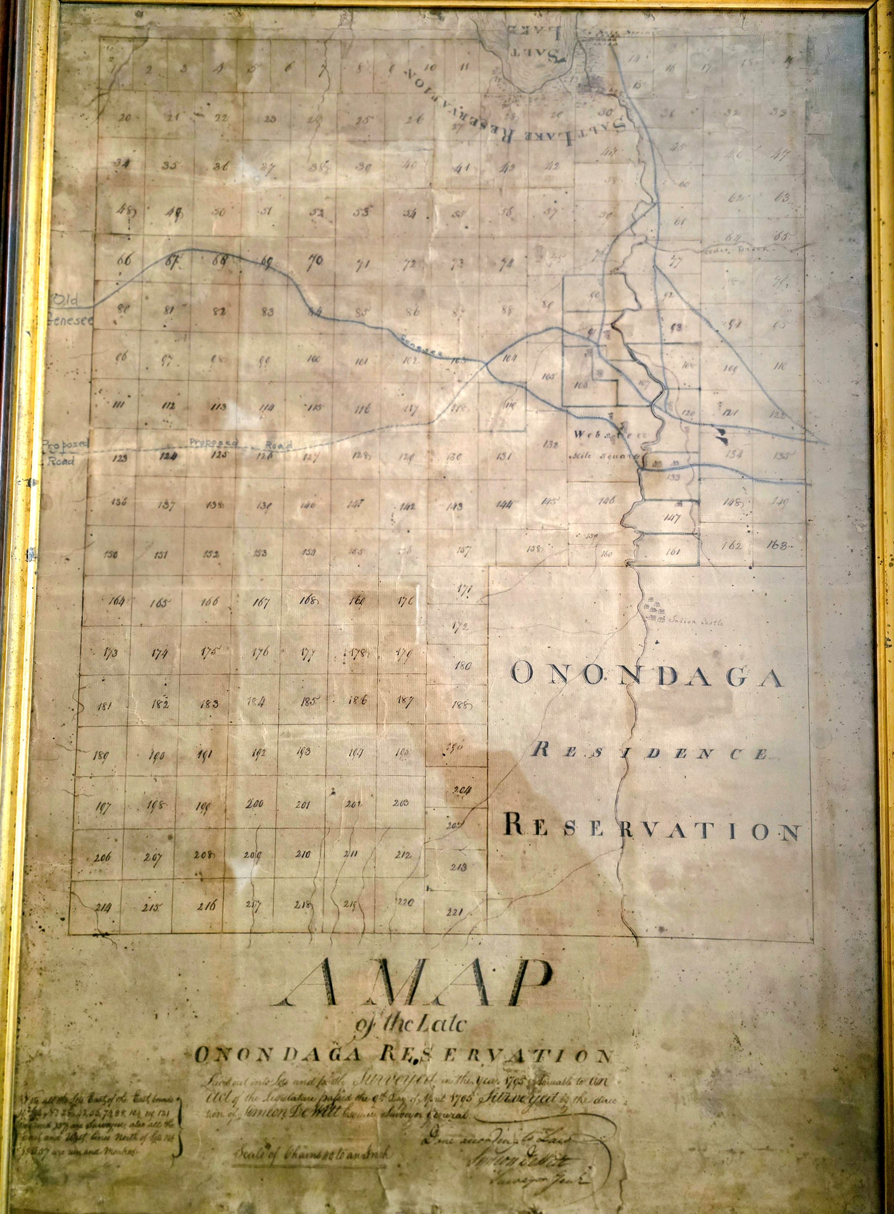
A Map of the Late Onondaga Reservation by Simeon DeWitt, 1795.

Slide 7
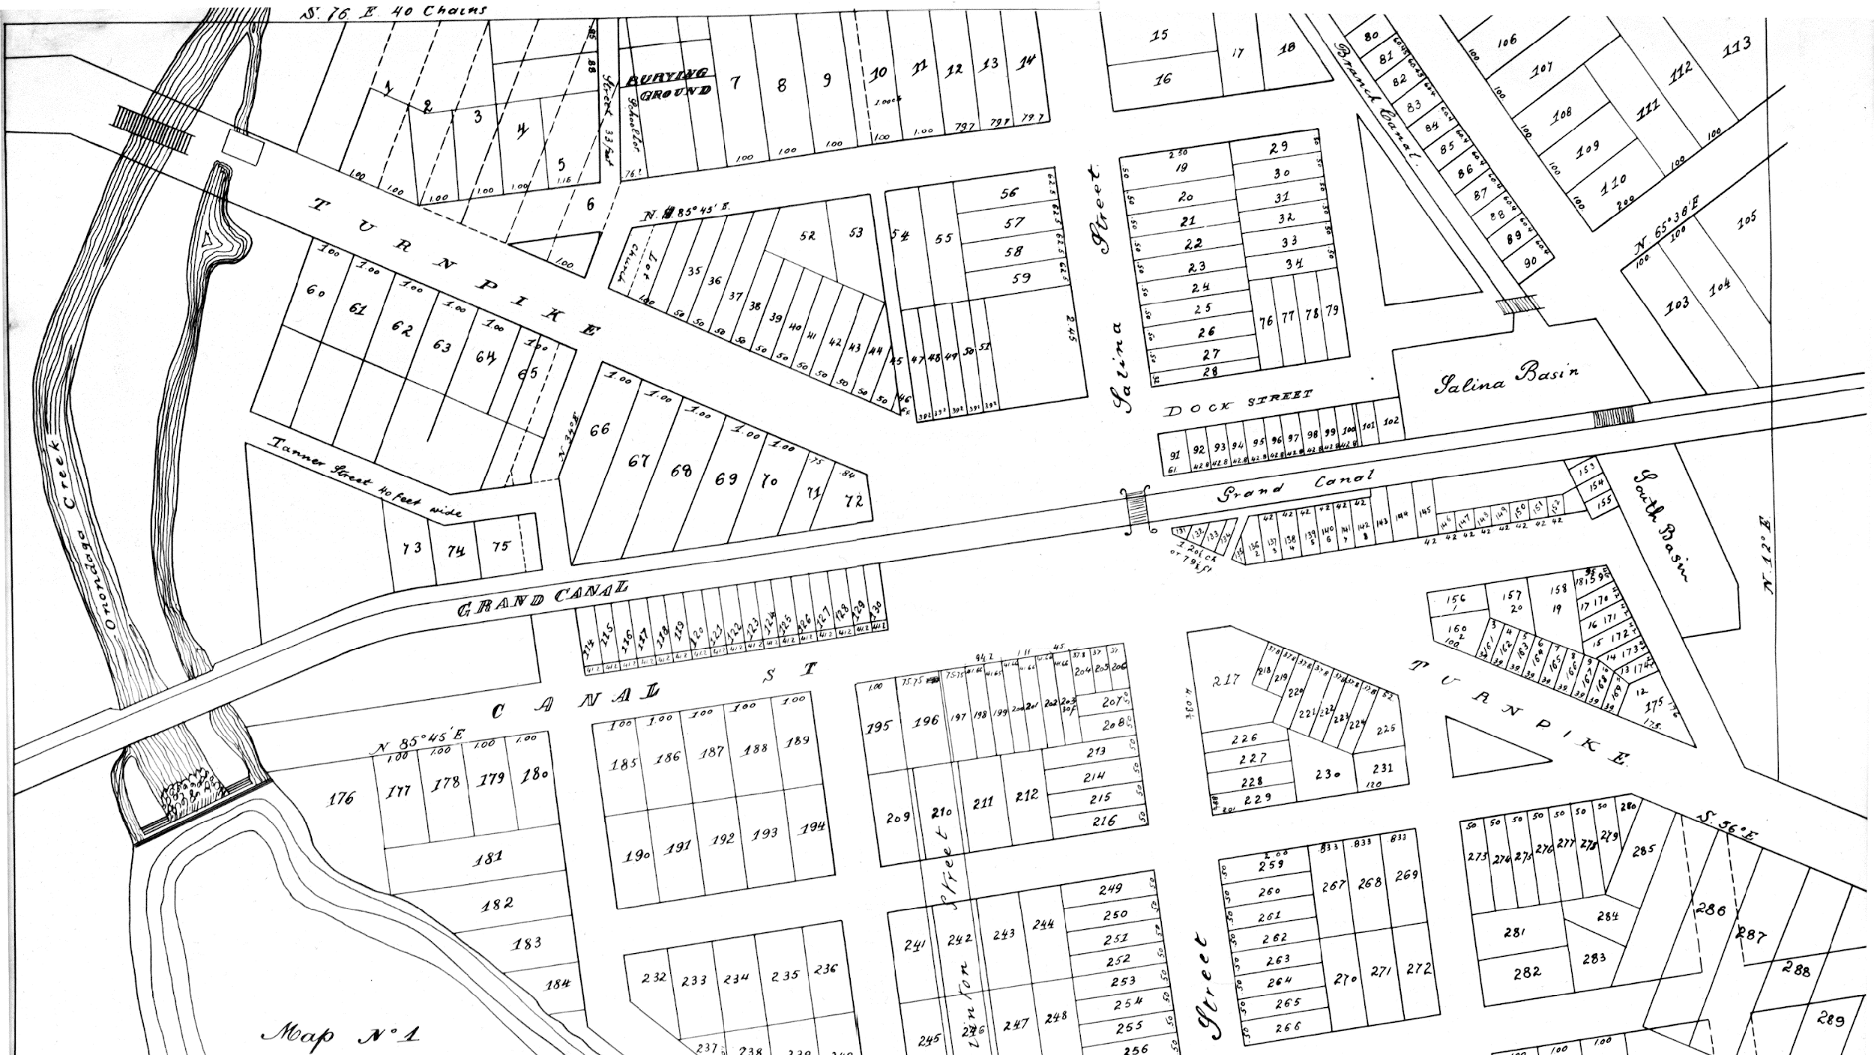
Notes:
The Walton Tract, 1819 Abraham Walton buys it up in 1804

Slide 8
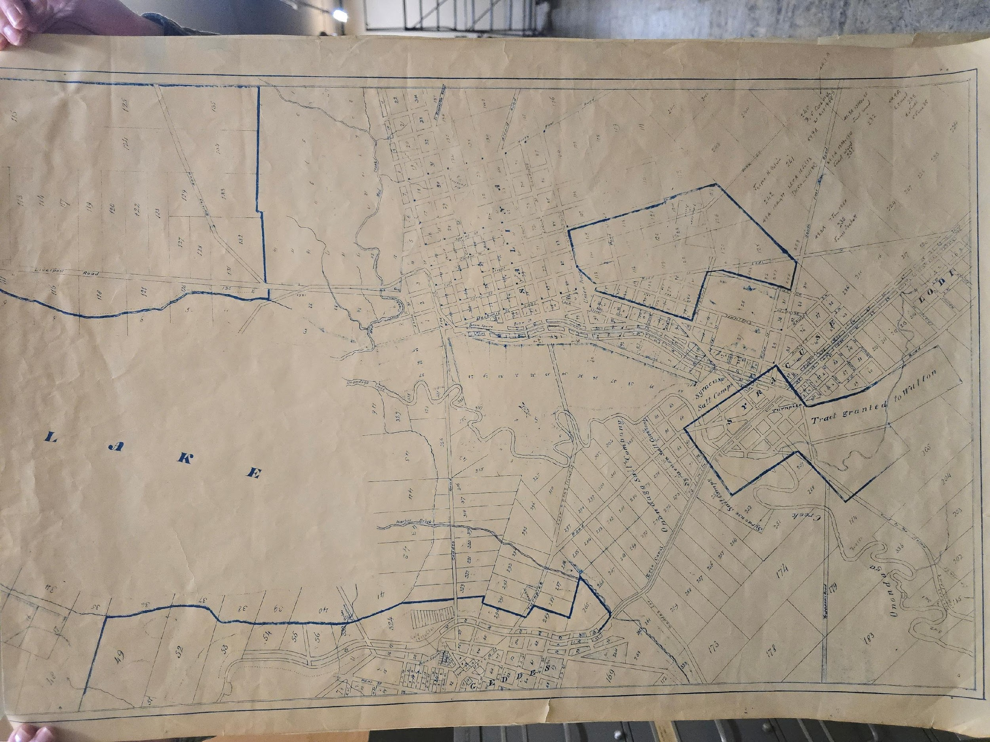
SYRACUSE,
1825
POPULATION 600
Notes:
The Syracuse Company: Moses Burnett, William James, James McBride, John and Isiah Townsend

Slide 9
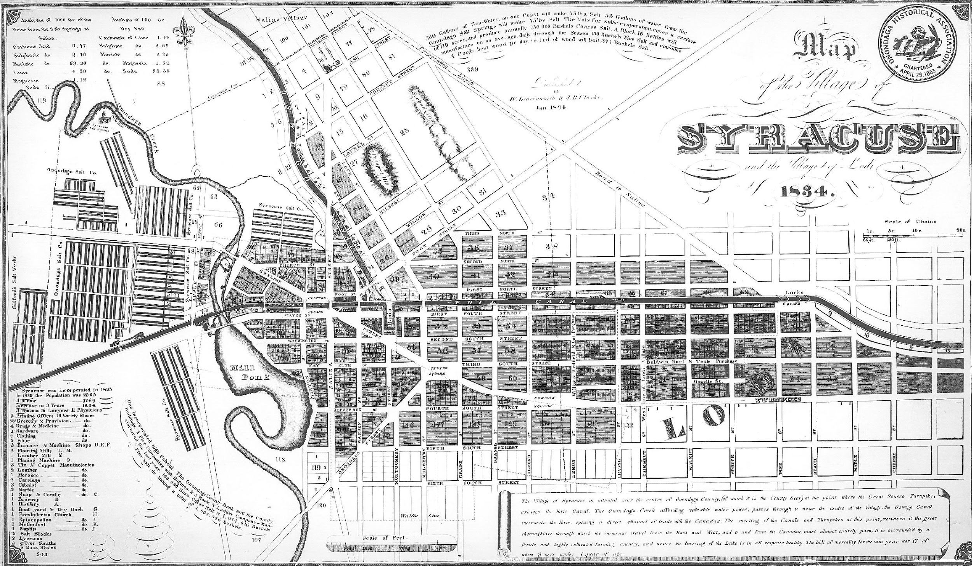
Notes:
The Syracuse Company map 1834, notes the expansion of settlement and population of the village of Syracuse after the completion of the Erie Canal in 1825. The parallel lines on the left of the map represent the expansive infrastructure of the salt industry that supplied 80% of the nation’s salt. The Full Circle Project is located in the area marked by the yellow rectangle.

Slide 10
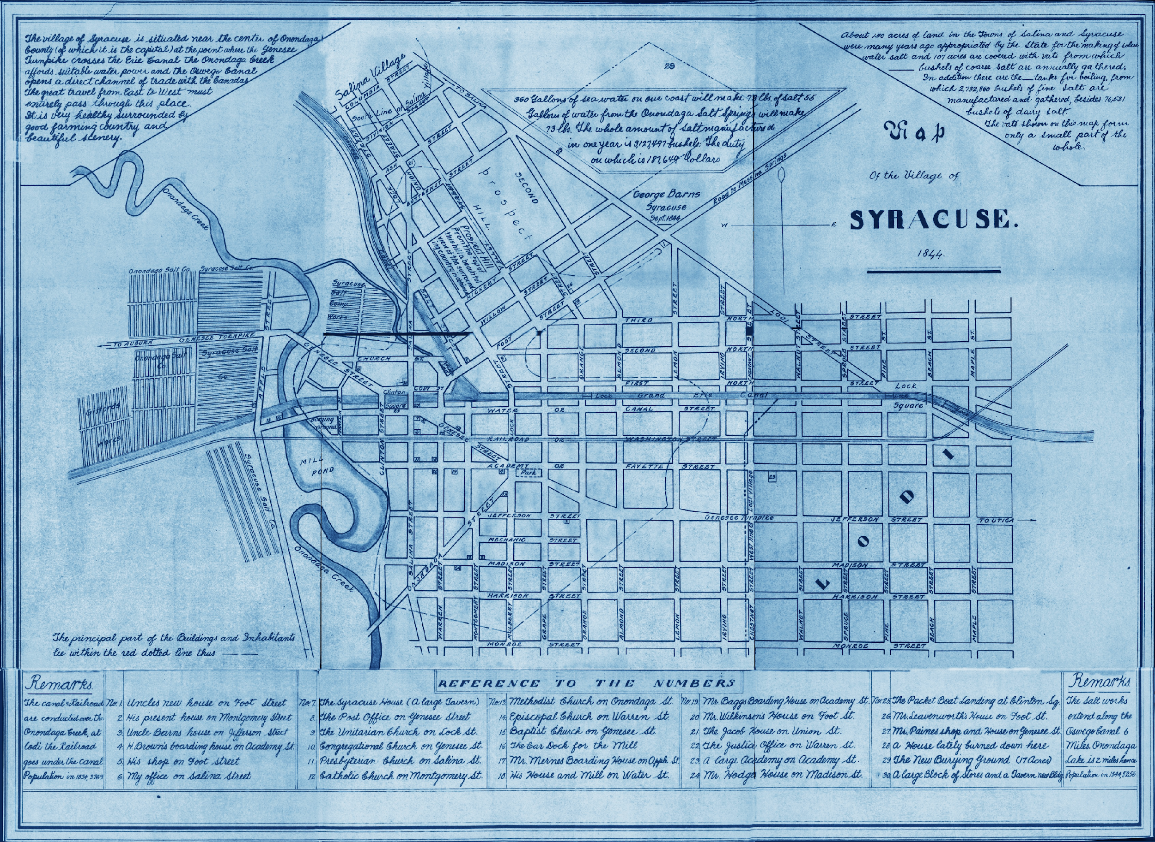
Notes:
The Village of Syracuse 1844. The Full Circle Project Site is marked by the yellow square.

Slide 11
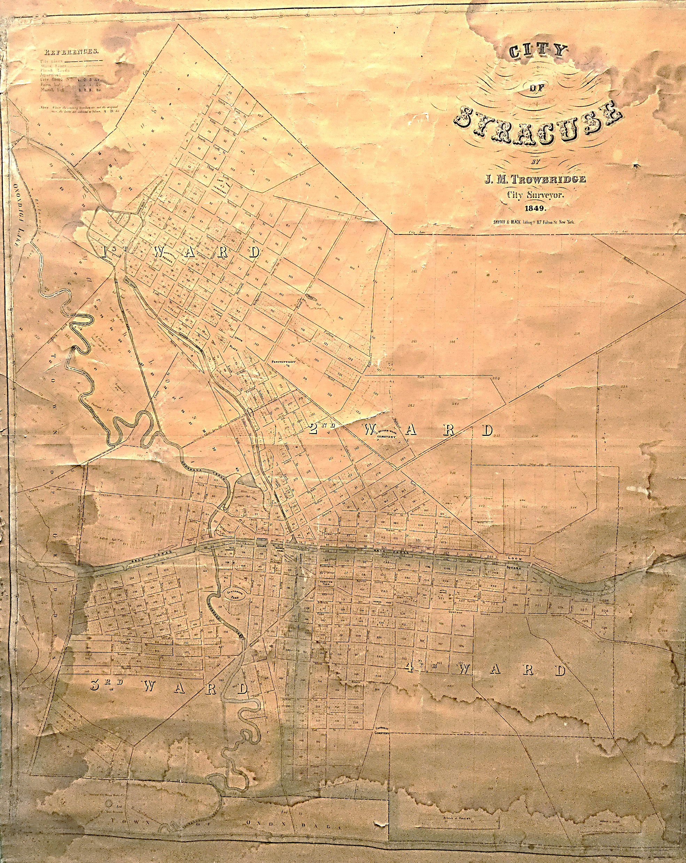
SYRACUSE
1849
POPULATION, 22, 271
Notes:
The Villages of Syracuse and Salina merge in 1847, and the City of Syracuse is incorporated.

Slide 12
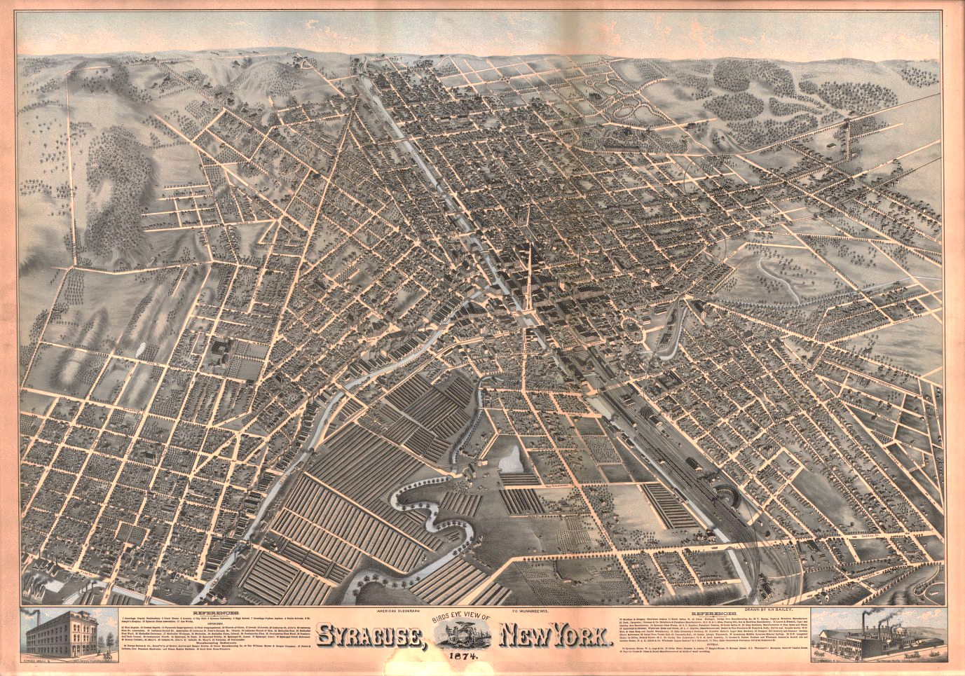
Population: 1874 48,000
Notes:
Syracuse 1874. Erie Canal continues to thrive after a period of enlargement, but railroads become a competitive mode of transportation for goods and people. Syracuse’s population grows to 48,000

Slide 13
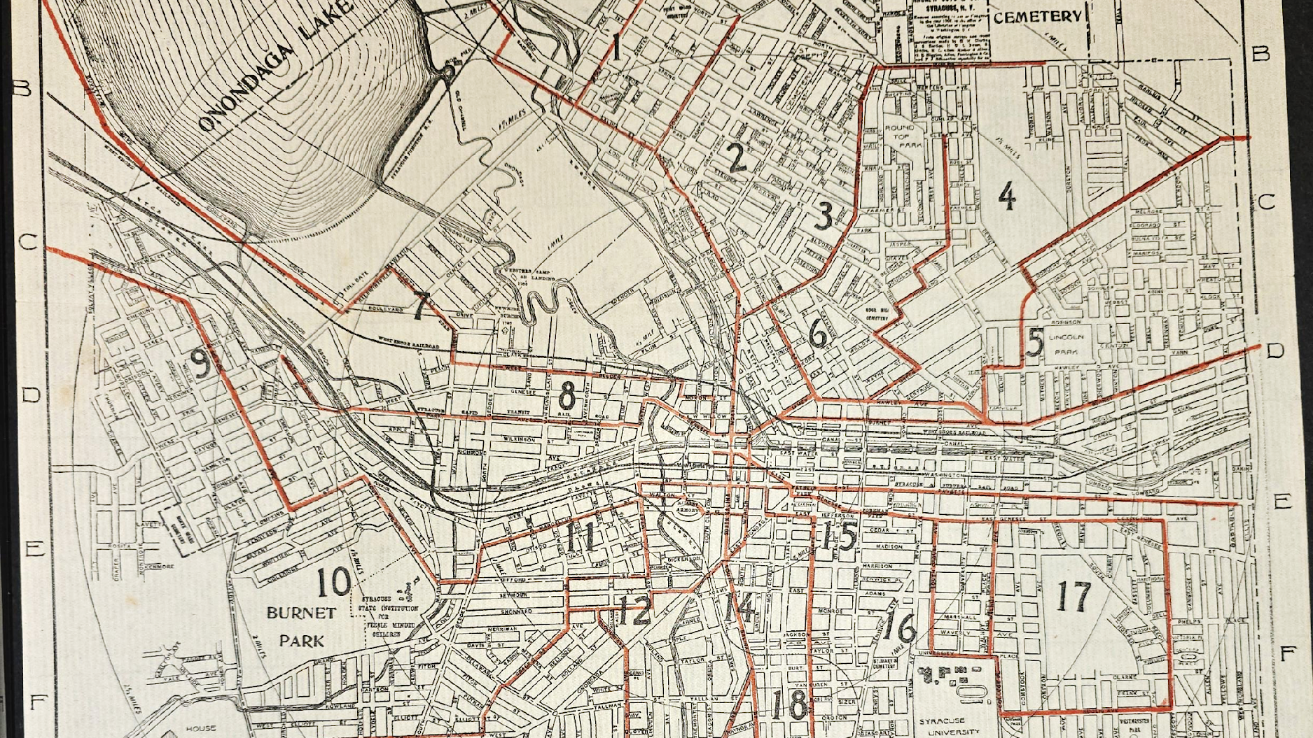
BOYD’S MAP, 1905
POPULATION:115,000
Notes:
Red lines delineate electric trolley cars. The population in 1905 is 115,000. The Full Circle project site is marked by a yellow square.

Slide 14
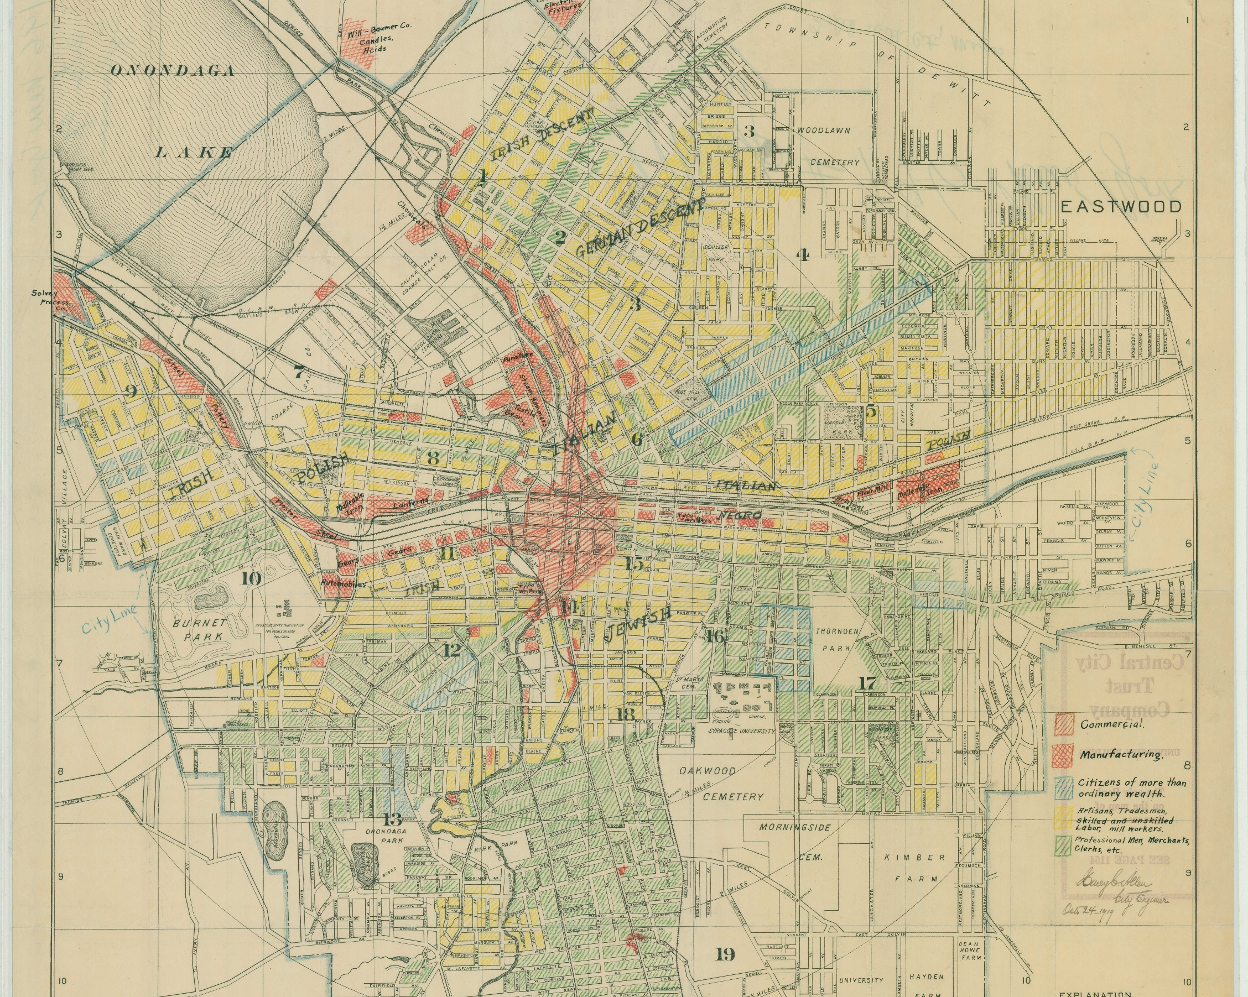
SYRACUSE, 1919.
LIKELY MADE BY CITY ENGINEER, HENRY ALLEN
POPULATION: 170,000
Notes:
This 1919 Map shows markings of the various ethnic neighborhoods and industries throughout the city. The Full Circle project site is noted by the yellow square.

Slide 15
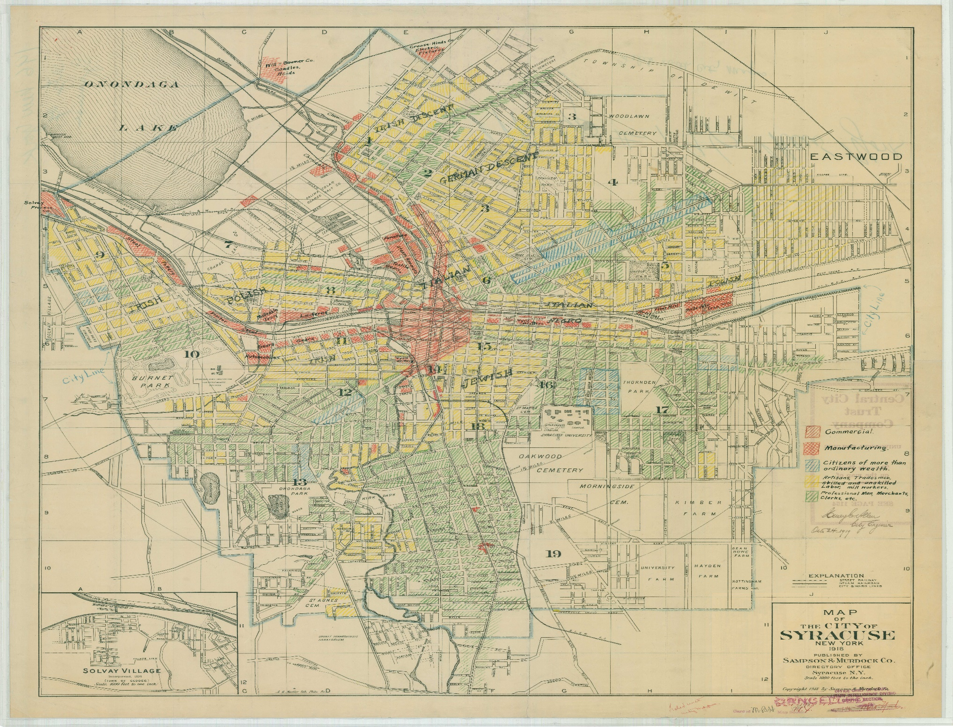
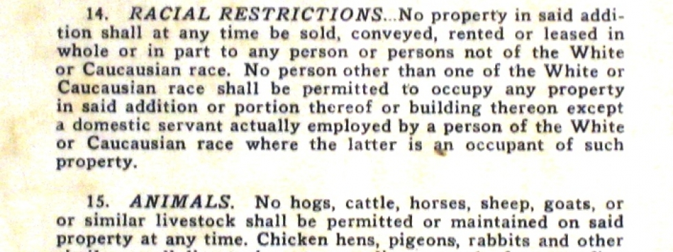
Map of Syracuse, 1919
Note the ethnic delineations and
neighborhoods.

Slide 16
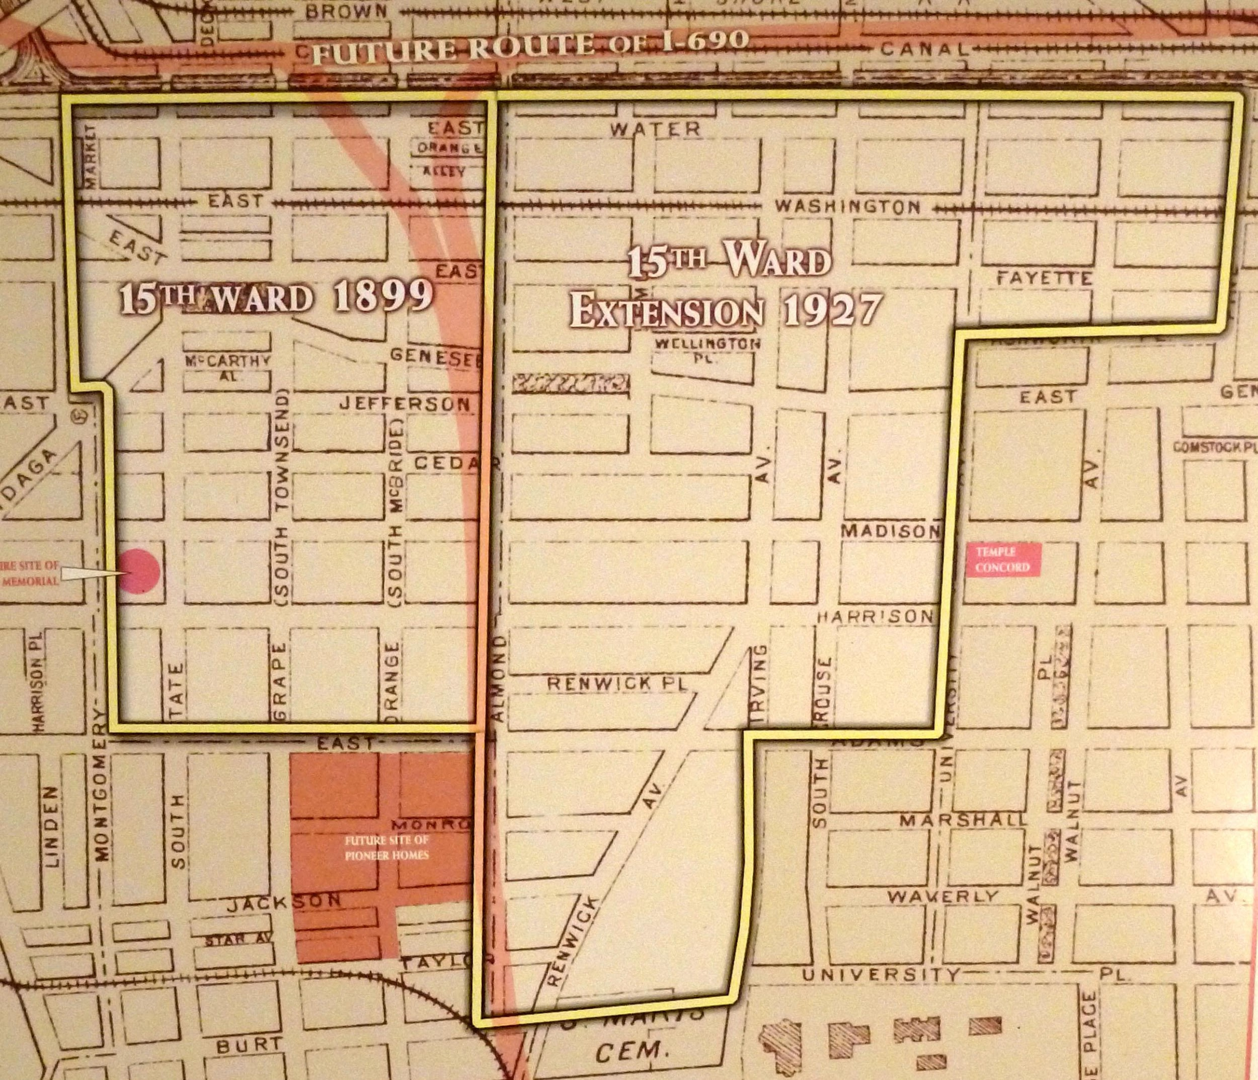
15TH WARD, 1927
Notes:
The 15th Ward was a vibrant, historically Black and Jewish neighborhood in Syracuse, NY, that was largely demolished in the 1950s and 60s for the construction of Interstate 81. Known as a tight-knit community, its destruction displaced thousands of families, destroyed local businesses, and created lasting economic and racial disparities. The removal of I-81 is currently underway, and will remove a mile-long viaduct through this area, followed by new housing infrastructure and a community grid. The Full Circle project site is marked in yellow.

Slide 17
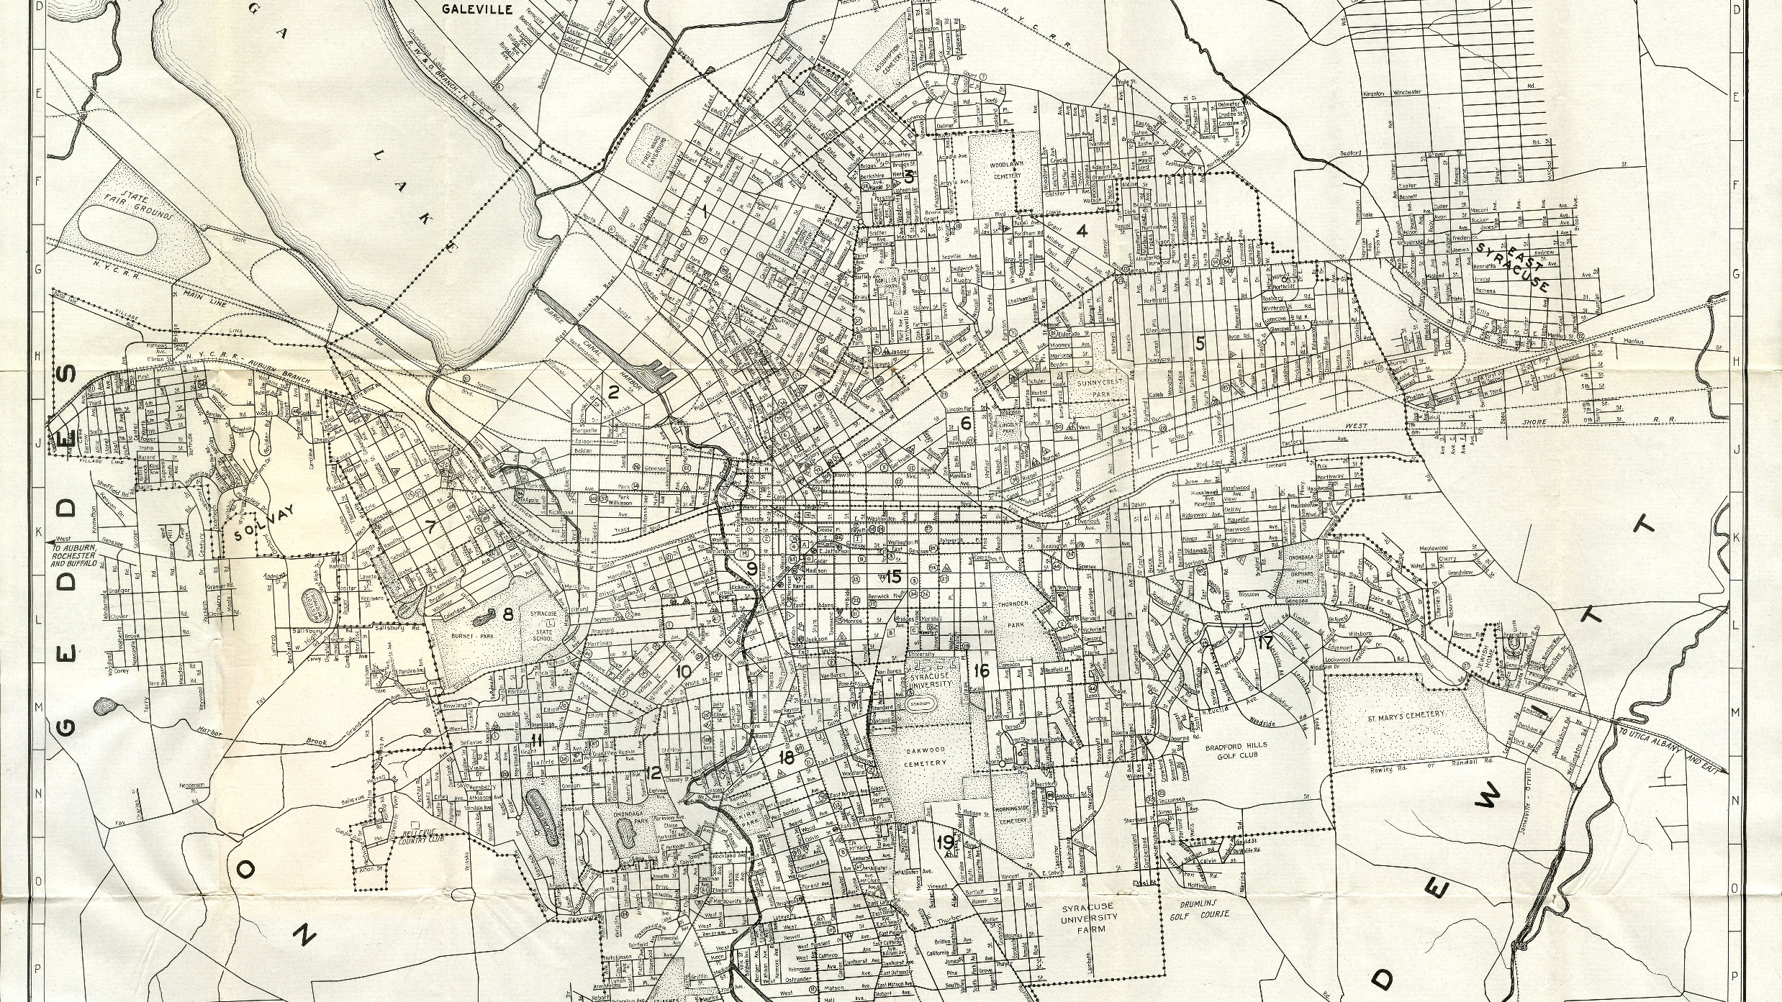
1935 POPULATION
207,000

Slide 18
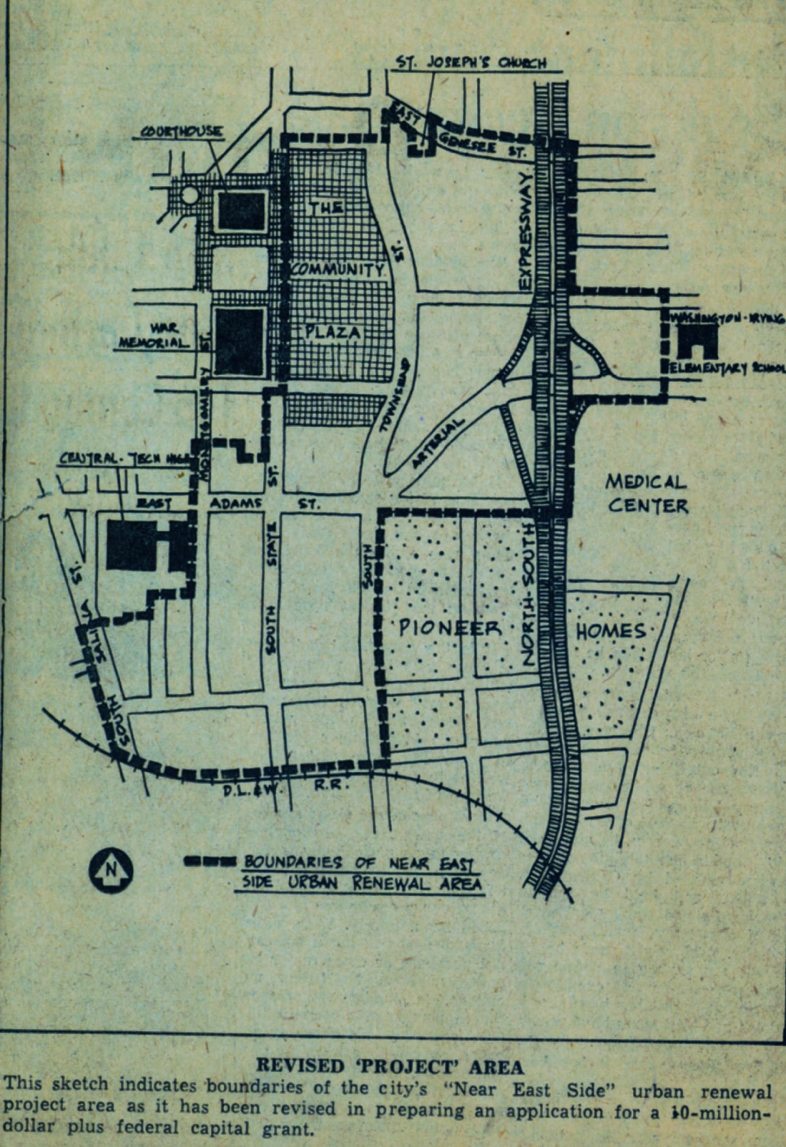
REVISED ROUTE OF INTERSTATE 81, 1960.
POPULATION: 216,000
Notes:
Peak population of city in the 1950s over 220k. The Full Circle project site is marked in yellow.

Slide 19
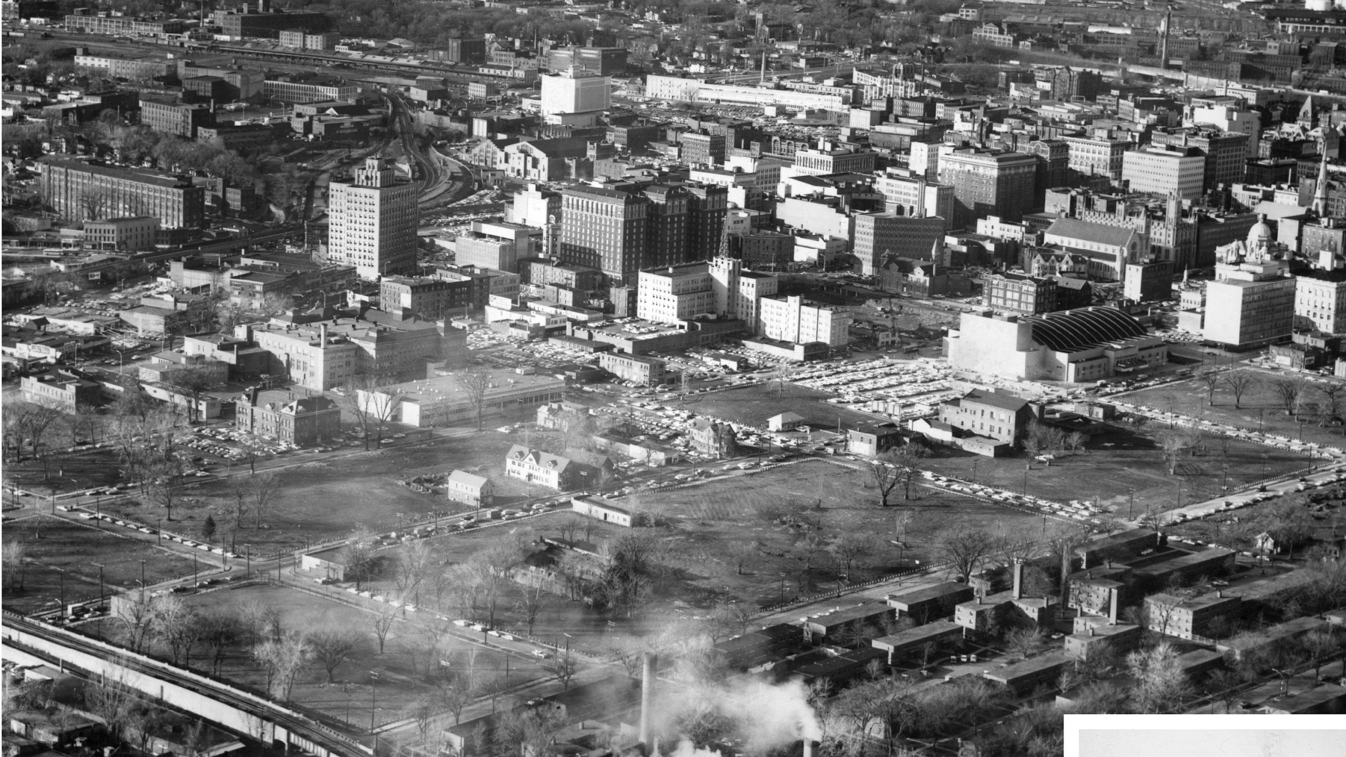
THE 15TH WARD RAZED, 1963
Notes:
The byproduct of interstate highway development and urban renewal. The Full Circle project site is marked in yellow.

Slide 20
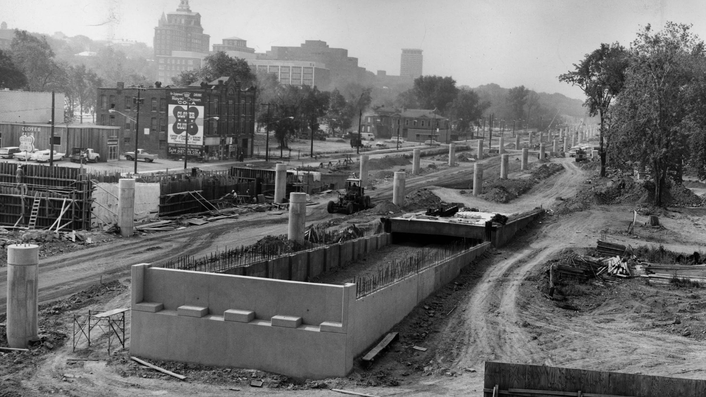

Slide 21
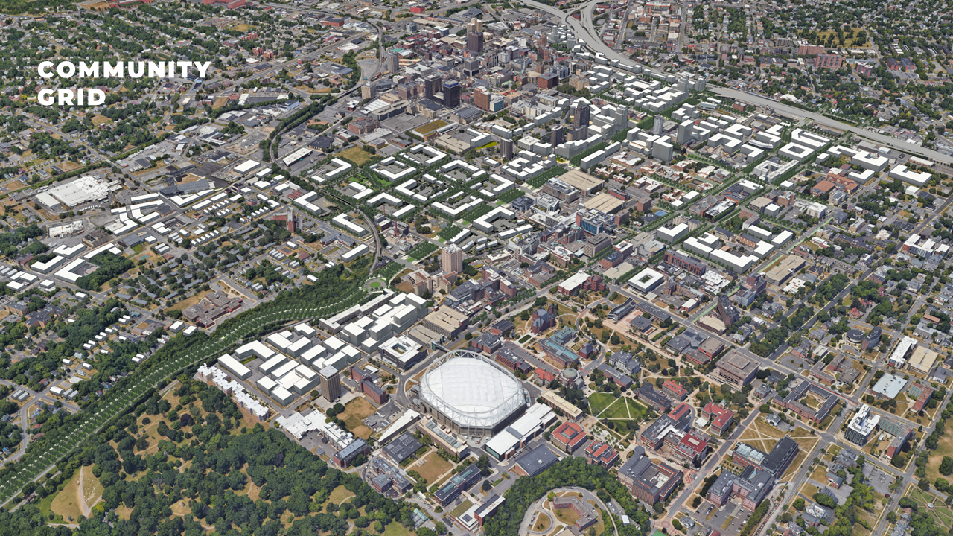
Image Courtesy of Dover, Kohl and Associates
Notes:
The community grid pattern shows greenways through the city where Interstate 81 will be removed. The yellow square marks the Full Circle project site.

